Slide 1
Chapter 8 SAMPLING and SAMPLING METHODS

Slide 2
SAMPLING
If the data you collect really are the same as you would get from the rest, then you can draw conclusions from those answers which you can relate to the whole group.
This process of selecting just a small group of cases from out of a large group is called sampling.

Slide 3
Sampling------
To whom do you want to generalize your results?
All doctors
School children
Indians
Women aged 15-45 years
Other
Can you sample the entire population?

Slide 4
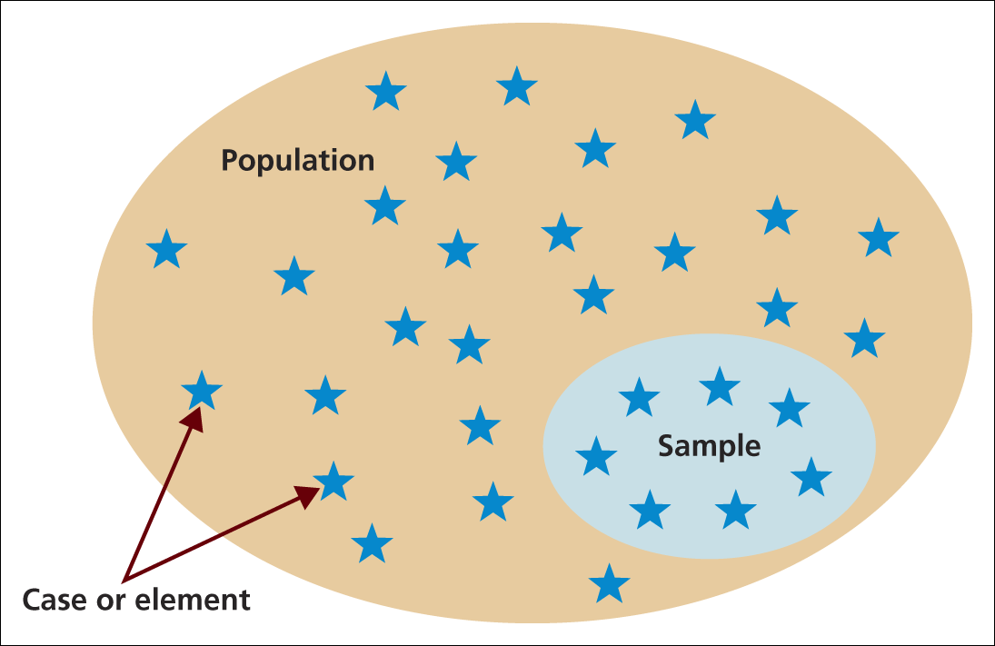

Slide 5
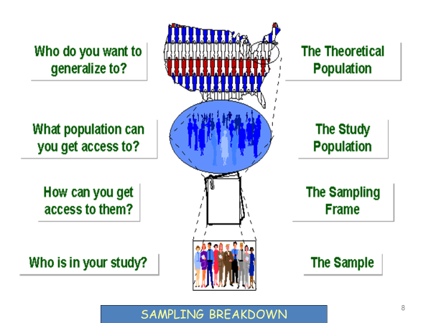
Sampling

Slide 6
The need to sample
Sampling- a valid alternative to a census when;
A survey of the entire population is impracticable
Budget constraints restrict data collection
Time constraints restrict data collection
Results from data collection are needed quickly

Slide 7
When doing a survey, the question inevitably arises:
how representative is the sample of the whole population, in other words;
how similar are characteristics of the small group of cases that are chosen for the survey to those of all of the cases in the whole group?

Slide 8
Sampling…………
3 factors that influence sample representative-ness
Sampling procedure
Sample size
Participation (response)
When might you sample the entire population?
When your population is very small
When you have extensive resources
When you don’t expect a very high response

Slide 9
Population in Research
It does not necessarily mean a number of people, it is a collective term used to describe the total quantity of things (or cases) of the type which are the subject of your study.
So a population can consist of certain types of objects, organizations, people or even events.

Slide 10
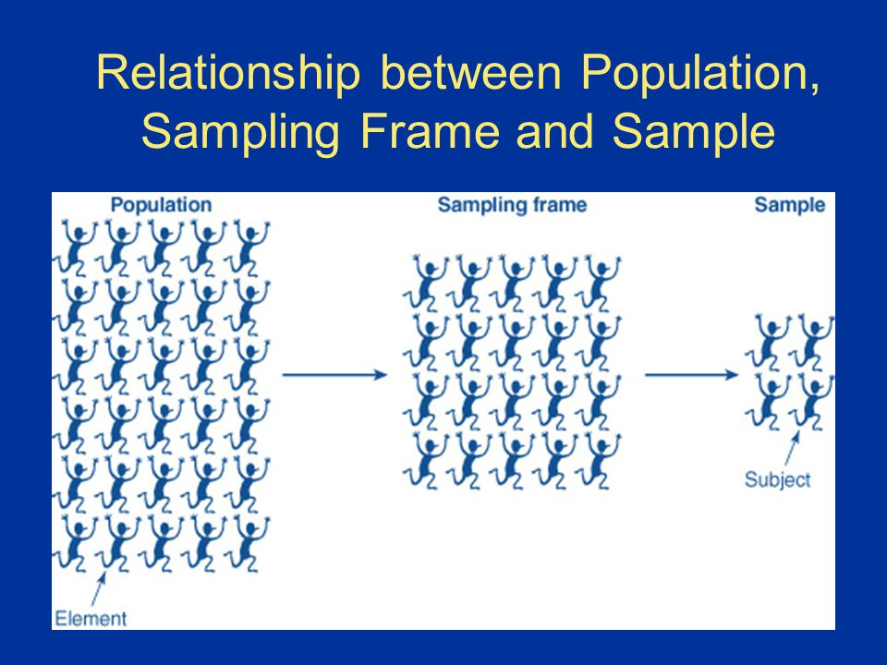
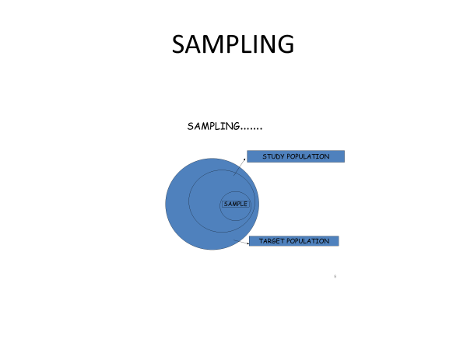
Sampling Frame
Within this population, there will probably be only certain groups that will be of interest to your study, this selected category is your sampling frame.

Slide 11
Populations can have the following characteristics:
Characteristics | Explains | Examples
homogeneous | all cases are similar | bottles of beer on a production line
stratified | contain strata or layers | people with different levels of income: low, medium, high
proportional stratified | contains strata of known proportions | percentages of different nationalities of students in a university
grouped by type | contains distinctive groups | of apartment buildings – towers, slabs, villas, tenement blocks
grouped by location | different groups according to where they are | animals in different habitats – desert, equatorial forest, savannah, tundra

Slide 12
SAMPLING METHODS

Slide 13
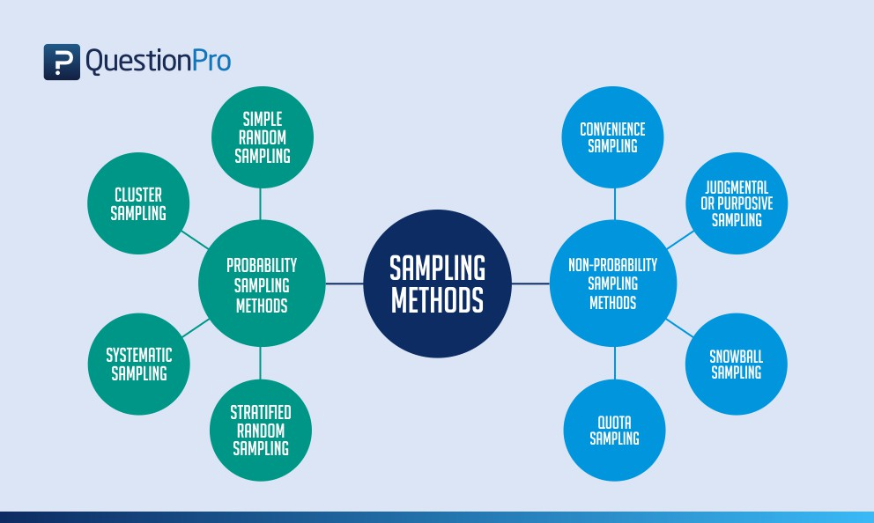
Sampling techniques

Slide 14

Probability sampling techniques give the most reliable representation of the whole population.
Non-probability techniques, relying on the judgment of the researcher or on accident, cannot generally be used to make generalizations about the whole population.

Slide 15
Probability Sampling
It is a sampling technique in which sample from a larger population are chosen using a method based on the theory of probability.
For a participant to be considered as a probability sample, he/she must be selected using a random selection.
The most important requirement of probability sampling is that everyone in your population has a known and an equal chance of getting selected.
Probability sampling uses statistical theory to select randomly, a small group of people (sample) from an existing large population and then predict that all their responses together will match the overall population.

Slide 16
Types of Probability Sampling
Four main techniques used for a probability sample:
Simple random
Stratified random
Cluster
Systematic

Slide 17
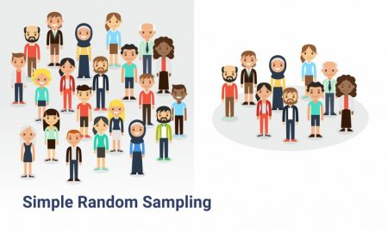
Simple random sampling
As the name suggests is a completely random method of selecting the sample. This sampling method is as easy as assigning numbers to the individuals (sample) and then randomly choosing from those numbers through an automated process.
A probability sampling scheme is one in which every unit in the population has a chance (greater than zero) of being selected in the sample, and this probability can be accurately determined.

Slide 18
WOR Vs WR
Sampling schemes may be without replacement ('WOR' - no element can be selected more than once in the same sample) or with replacement ('WR' - an element may appear multiple times in the one sample).
For example, if we catch fish, measure them, and immediately return them to the water before continuing with the sample, this is a WR design, because we might end up catching and measuring the same fish more than once. However, if we do not return the fish to the water (e.g. if we eat the fish), this becomes a WOR design

Slide 19
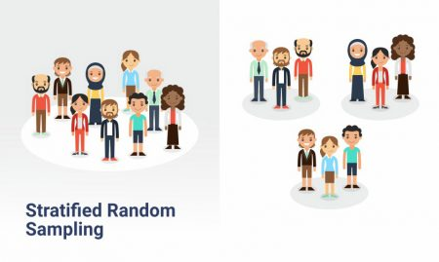
Stratified Random sampling
Iinvolves a method where a larger population can be divided into smaller groups, that usually don’t overlap but represent the entire population together. While sampling these groups can be organized and then draw a sample from each group separately. A common method is to arrange or classify by sex, age, ethnicity and similar ways.

Slide 20
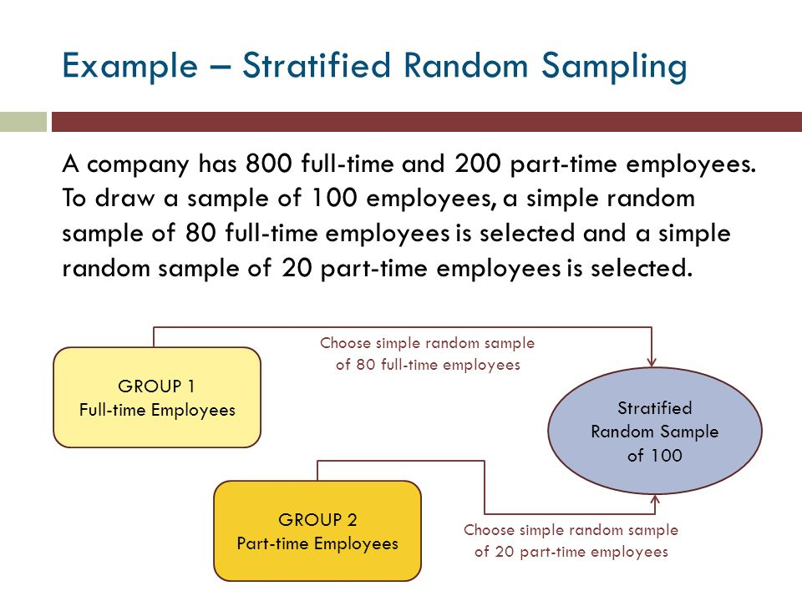

Slide 21

Cluster random sampling
It is a way to randomly select participants when they are geographically spread out. Cluster sampling usually analyzes a particular population in which the sample consists of more than a few elements, for example, city, family, university etc. The clusters are then selected by dividing the greater population into various smaller sections.

Slide 22
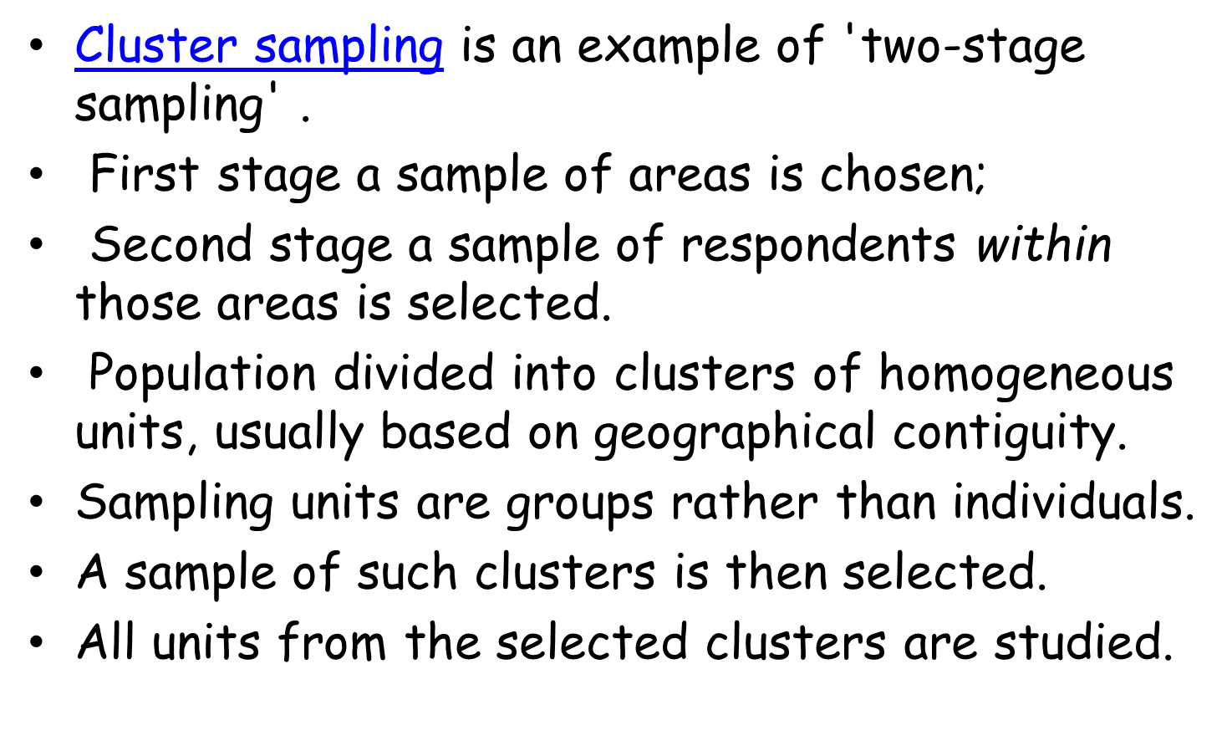

Slide 23
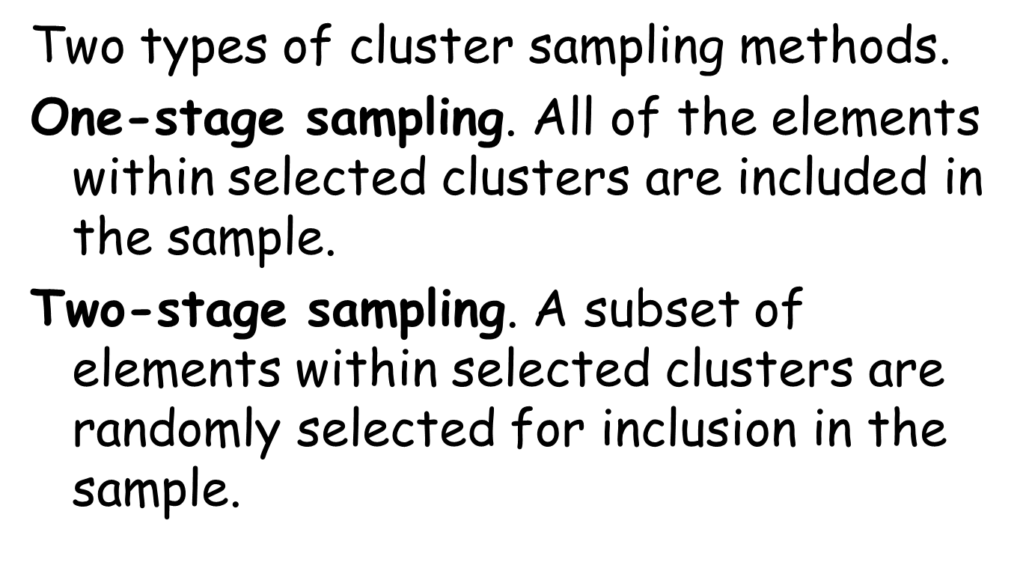
Types of Cluster Sampling Methods

Slide 24
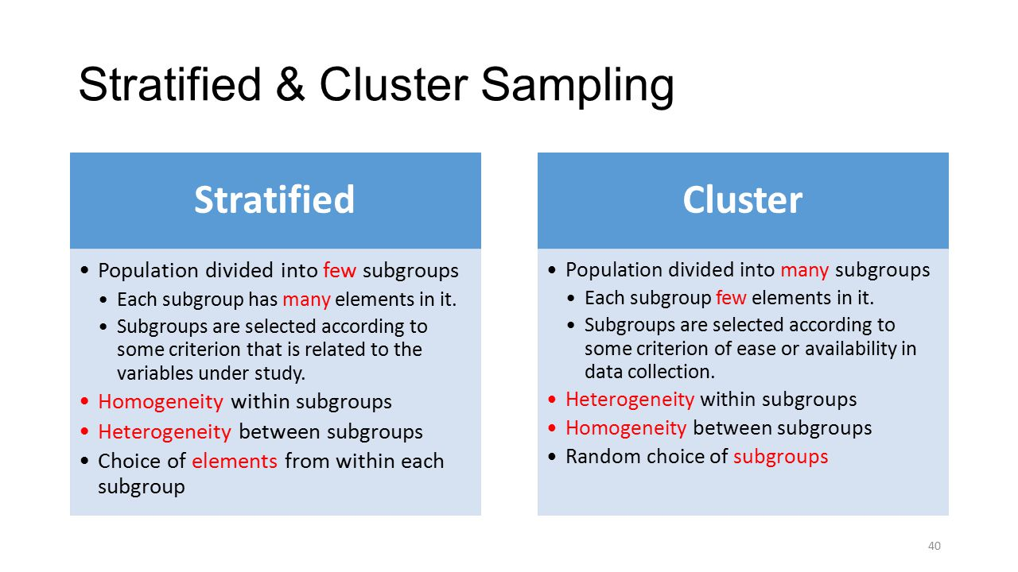

Slide 25
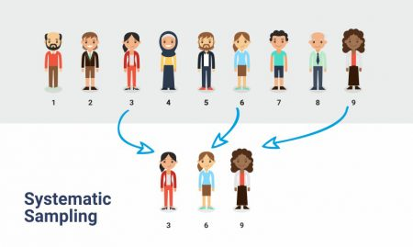
Systematic Sampling
It is when you choose every “nth” individual to be a part of the sample. For example, you can choose every 5th person to be in the sample. Systematic sampling is an extended implementation of the same old probability technique in which each member of the group is selected at regular periods to form a sample. There’s an equal opportunity for every member of a population to be selected using this sampling technique.

Slide 26
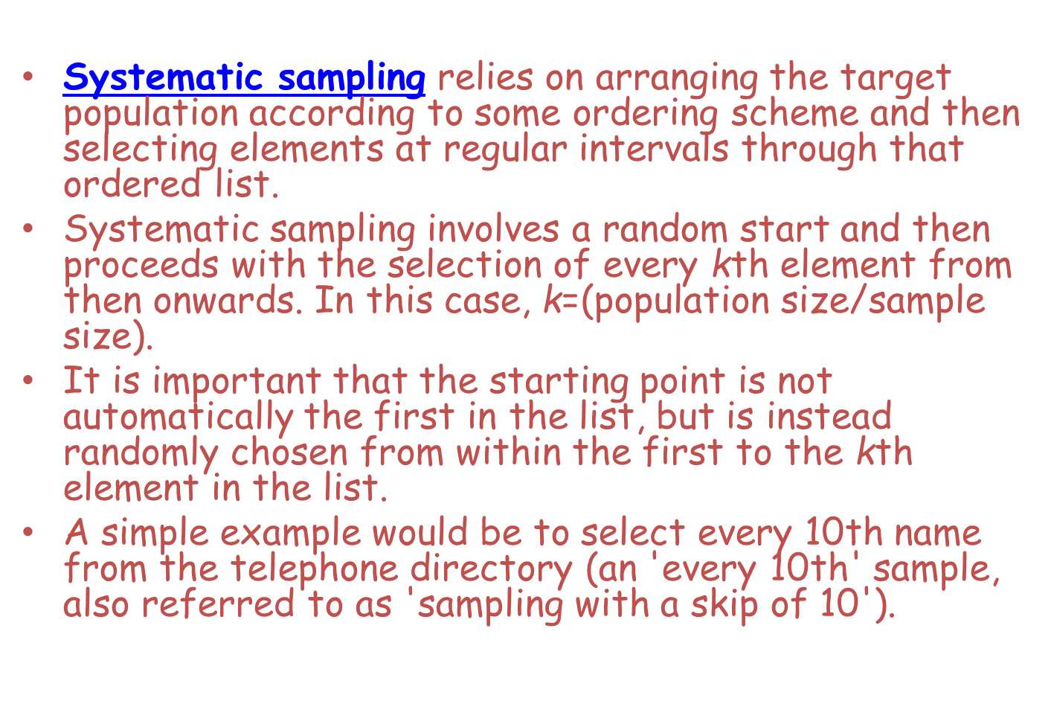
Systematic Sampling……….

Slide 27
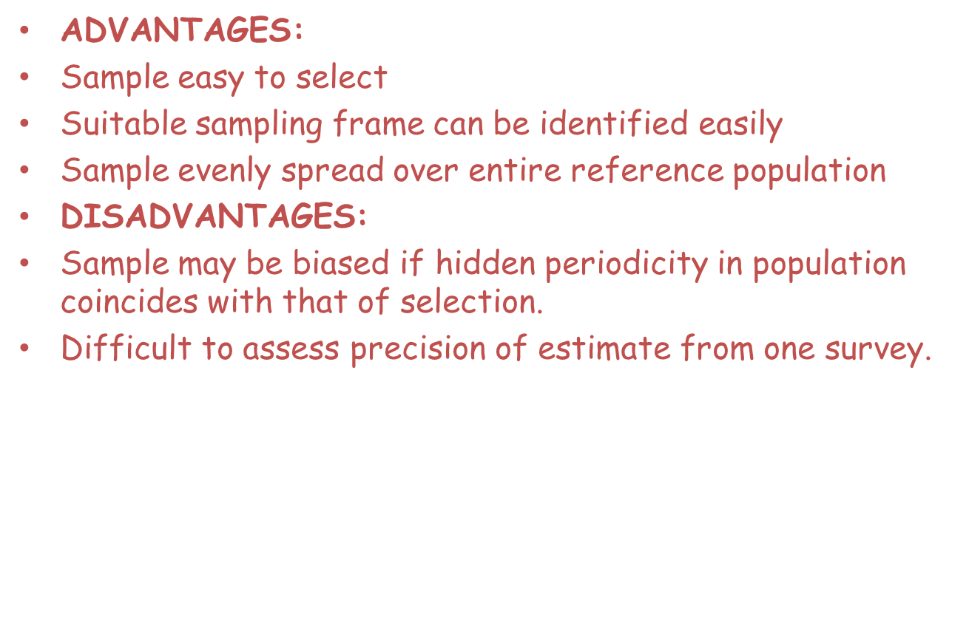

Slide 28
Types of Non-probability Sampling
Four main techniques used for a non-probability sample:
Convenience
Judgemental
Snowball
Quota

Slide 29
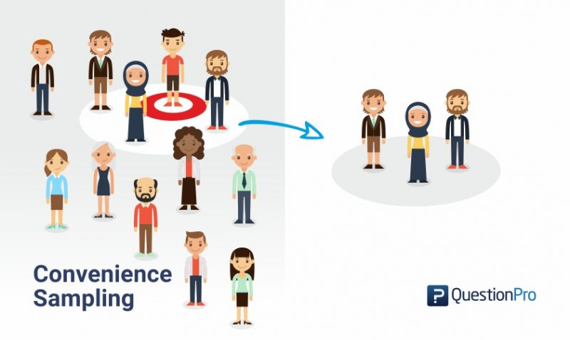
Convenience Sampling
It is a non-probability sampling technique used to create sample as per ease of access, readiness to be a part of the sample, availability at a given time slot or any other practical specifications of a particular element.
Convenience sampling involves selecting haphazardly those cases that are easiest to obtain for your sample, such as the person interviewed at random in a shopping center for a television program.

Slide 30
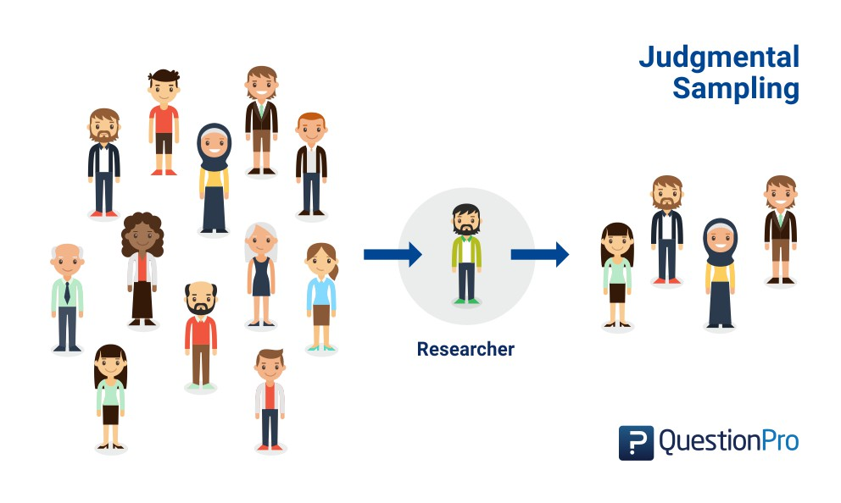
Judgmental Sampling
In the judgmental sampling, also called purposive sampling, the sample members are chosen only on the basis of the researcher’s knowledge and judgment.
It enables you to select cases that will best enable you to answer your research question(s) and to meet your objectives.

Slide 31
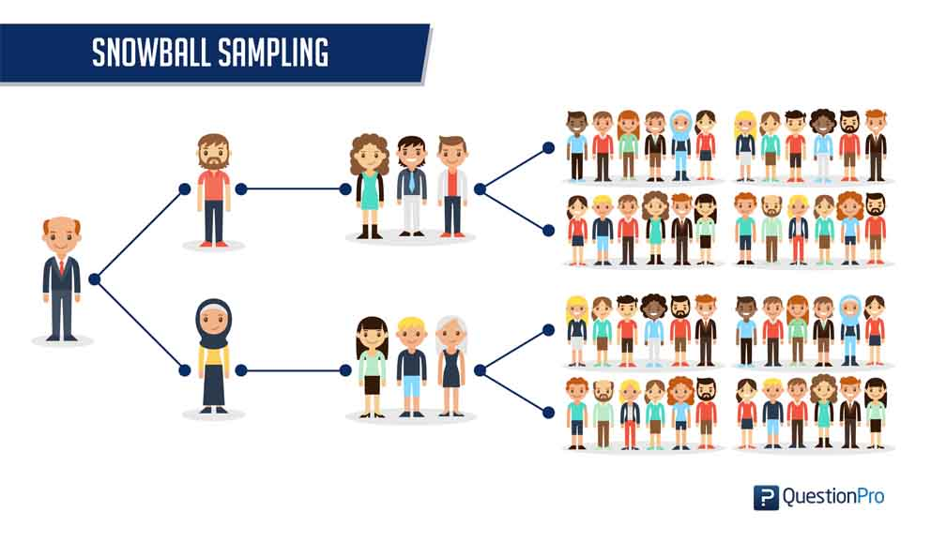
Snowball Sampling
Snowball sampling method is purely based on referrals and that is how a researcher is able to generate a sample. Therefore this method is also called the chain-referral sampling method.
This sampling technique can go on and on, just like a snowball increasing in size (in this case the sample size) till the time a researcher has enough data to analyze, to draw conclusive results that can help an organization make informed decisions.

Slide 32
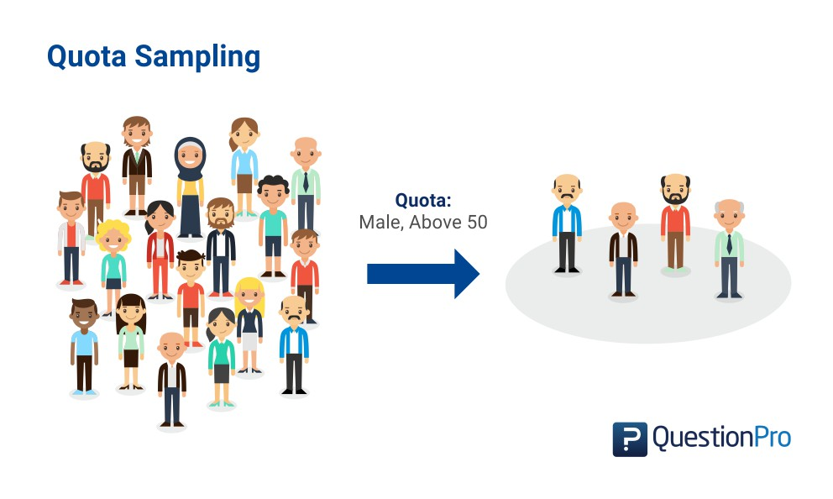
Quota Sampling
Selection of members in this sampling technique happens on basis of a pre-set standard. In this case, as a sample is formed on basis of specific attributes, the created sample will have the same attributes that are found in the total population. It is an extremely quick method of collecting samples.
Quota sampling is therefore a type of stratified sample in which selection of cases within strata is entirely non-random.

Slide 33
Quota Sampling……..
The population is first segmented into mutually exclusive sub-groups, just as in stratified sampling.
Then judgment used to select subjects or units from each segment based on a specified proportion.
For example, an interviewer may be told to sample 200 females and 300 males between the age of 45 and 60.
It is this second step which makes the technique one of non-probability sampling.
In quota sampling the selection of the sample is non-random.
For example interviewers might be tempted to interview those who look most helpful. The problem is that these samples may be biased because not everyone gets a chance of selection. This random element is its greatest weakness and quota versus probability has been a matter of controversy for many years

Slide 34
READ OTHER TECHNIQUES
Multistage Sampling.
Multiphase sampling

